Slide 1

OOP Overview
Data modeling
Abstraction
Encapsulation
Objects
Classes
Inheritance
Polymorphism

Slide 2
Data modeling

Slide 3
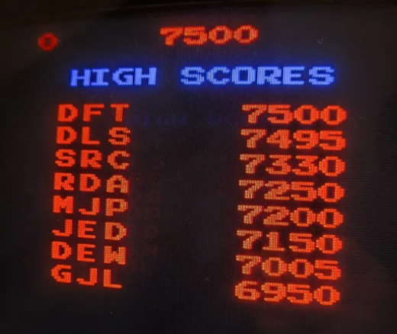
Highscores
Model data
How to store the data in a meaningful way
names
DFT
DLS
SRC
RDA
MJP
…
scores
7500
7495
7330
7250
7200
…

Slide 4
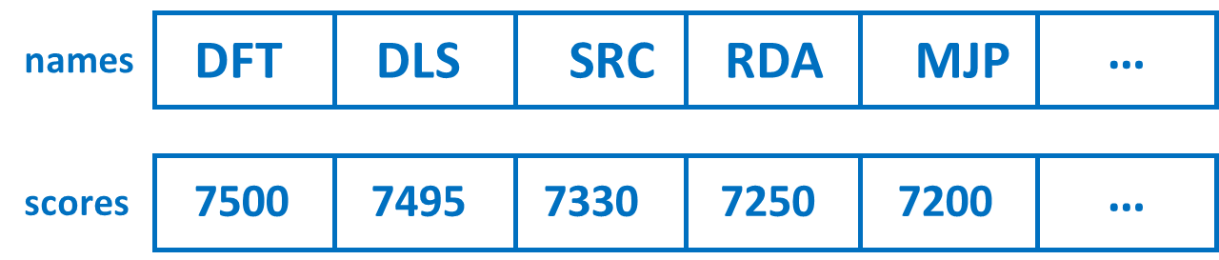
Problem?
UIDisplay file
SaveGameData file
string names[]
int scores[]
string data
// where are the arrays defined?!
function DisplayScores()
for each array index i
display names[i]
display scores[i]
end for
end function
function saveData()
for each array index i
save names[i] to data
save scores[i] to data
end for
end function
… lots more code
… lots more code
lots more files!

Slide 5






And do we even think of things as separate collections of individual parts?
bike 0
bike 1
bike 2
bike 3
bike 4
bike n
Front wheels
…
Back wheels
…
Saddle
…
… more parts arrays

Slide 6



… or as an object that is made up of its parts?
Handlebars
Saddle
Crossbar
Brakes
BackWheel
DownTube
Pedal
Gears
FrontWheel
Pedal

Slide 7
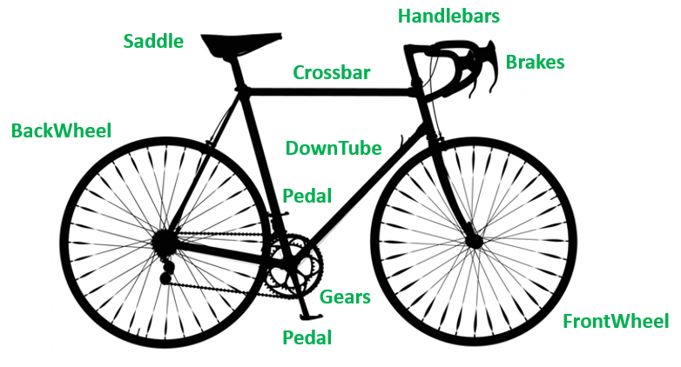
Bicycle
{
Saddle
Crossbar
Handlebars
Brakes
DownTube
Pedal1
Pedal2
Gears
FrontWheel
BackWheel
}
Take the detailed bicycle and select the parts needed for your application.
This is what we call modeling the bicycle.
Data modeling is deciding on the best way to represent this data in your code – in this case, an an object.
But how to know which parts to focus on?
This leads to the concept of
Abstraction

Slide 8
The 4 Pillars of
OOP
ABSTRACTION
INHERITANCE
ENCAPSULATION
POLYMORPHISM

Slide 9

Abstraction
What is abstraction in real life?
What is abstraction in programming?

Slide 10
Through the process of abstraction, a programmer hides all but the relevant data about an object in order to reduce complexity and increase efficiency.
https://whatis.techtarget.com/definition/abstraction
This is all the user of the bicycle needs to know!
ABSTRACTION

Slide 11
Scrollwheel
LMB
RMB
USB cable
Casing
A concrete example

Slide 12


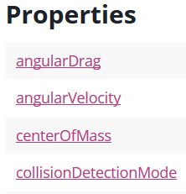
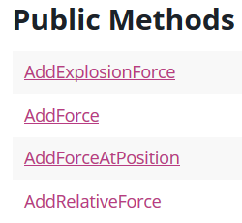
It’s the same for software development!
RigidBody component
force
We don’t want to know the implementation details … just what we have to do to perform the various operations (how to use it!)
Abstraction

Slide 13
Abstraction: Variable and Type
A variable is a user-friendly name for a memory location where data is stored. Instead of using raw addresses like 0xFA49130E, variables let us refer to data easily, even if the memory location changes.
int age
age
garbage
garbage
17
0
22
0xFA49130E
age = 17
So, a variable is an abstraction of something much more complex!
garbage
0xFA49130E
= 17
garbage
age = 22
garbage
0xFA49130E
= 22
A more abstract example
https://nus-cs2030.github.io/1718-s2/lec01/index.html

Slide 14
garbage
garbage
0
0xFA49130E
garbage
variable
garbage
garbage
type
name
value
Remember: a variable in your code is mapped to a physical address in memory!

Slide 15
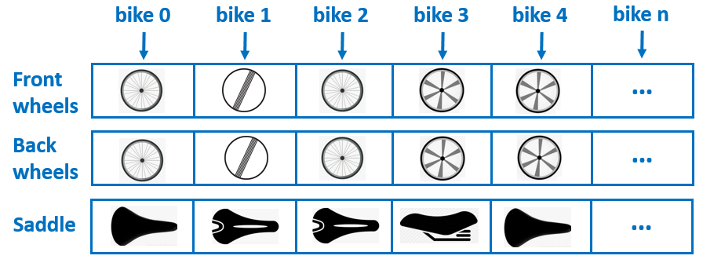



Abstraction and Data Modeling are closely related
Abstraction
Bicycle
{
Saddle
Crossbar
Handlebars
Brakes
DownTube
Pedal1
Pedal2
Gears
FrontWheel
BackWheel
}
Multiple cross-referenced arrays of bicycle parts
A single array of Bicycle objects
Data Modeling

Slide 16

Watch these videos about Abstraction and Data Modeling
https://www.youtube.com/watch?v=jV-7Hy-PF2Q
(2:28)
https://www.youtube.com/watch?v=_OVWjMkGsNY
(2:10)

Slide 17
class keyword
class name
class HighScore
{
public string Name;
public int Score;
}
body of the class
The class defines a template for creating HighScore objects
KDR
CNT
JES
251110
191880
151840

Slide 18
HighScore class definition
class HighScore
{
public string Name;
public int Score;
}
Data Model
HighScore class instances
DFT
DLS
SRC
This is just a way to model the data, and then create data that follows the model
7500
7495
7330
Data instances

Slide 19
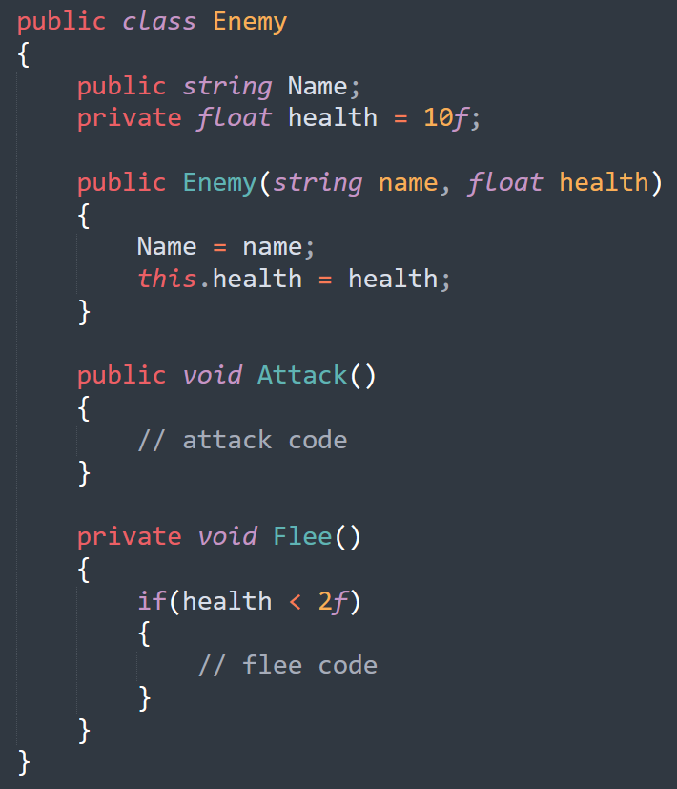
So, what is a class, then?
Type name
Data
;
Methods
You can think of a class as a definition of some type of thing in your program that has its own data, and ways to manipulate that data.
Your program can create one or more of these things, each with its own data and values for that data.
https://www.c-sharpcorner.com/UploadFile/ajyadav123/net-assembly-internals-part-1/

Slide 20

So, what is a thing?
A spaceship is a thing
It has data:
We can have one or more spaceship type things in our program
float xpos = 20f
float ypos = 0f
float speed = 53f
float xpos = 35f
float ypos = 85f
float speed = 10f
It has methods to manipulate data:
FireThruster()
Turn()
FireRocket()
FireThruster()
Turn()
FireRocket()

Slide 21

So, what is a thing?
An enemy robot is a thing
It has data:
float xpos = 20f
float ypos = 0f
float health = 8f
We can have one or more enemy robot things in our program
It has methods to manipulate data:
float xpos = 35f
float ypos = 85f
float health = 2f
Patrol()
Attack()
Flee()
Patrol()
Attack()
Flee()

Slide 22
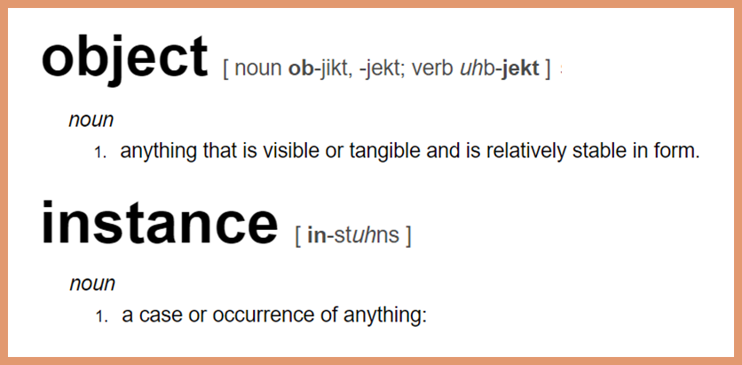
Of course, you know that things are really called objects – or instances.
We’ll look at this later

Slide 23
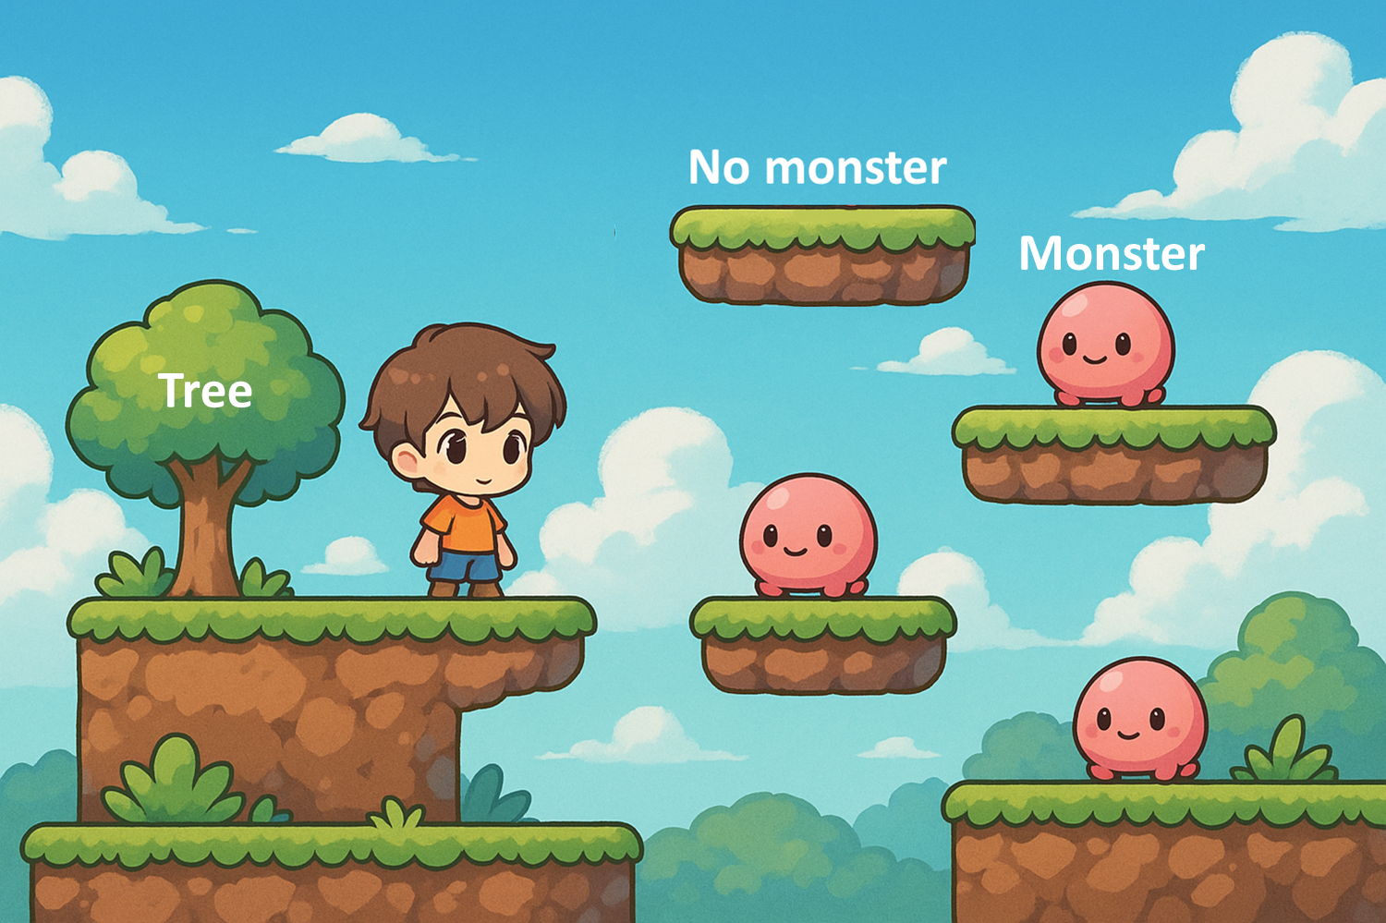
How to manage the platforms?
Exercise!
For each platform, we must know:
Transform (position)
Platform type (e.g. “monster”, “tree”)
Monster (which monster is on it)

Slide 24
Problems?!
public class PlatformsManager
{
private Transform[] transforms;
private string[] types; // "static", "monster"
private GameObject[] monsters; // must match length; null if no monster
public PlatformsManager(Transform[] transforms, string[] types, GameObject[] monsters)
{
this.transforms = transforms;
this.types = types;
this.monsters = monsters;
}
public void Initialise()
{
for (int i = 0; i < transforms.Length; i++)
{
if (types[i] == "monster" && monsters[i] != null)
{
monsters[i].transform.position = transforms[i].position + Vector3.up;
}
// other platform types handled here...
}
}
}

Slide 25
Problem
“m” : “monster”
“tr” : “tree”
Relies on array index synchronization.
transforms
t1 | t2 | t3 | t4 | t5 | t6 | t7 | t8 | t9 | t10
types
“m” | “m” | “tr” | “m” | “tr” | “tr” | “m” | “m” | “tr” | “m”
monsters
m1 | m2 | null | m3 | null | null | m4 | m5 | null | m6
if (types[i] == "monster" && monsters[i] != null)
{
monsters[i].transform.position =
transforms[i].position + Vector3.up;
}
If you change order or mismatch arrays, things break silently.
You must check types[i] and monsters[i] → unnecessary coupling.

Slide 26
Better design with abstraction
public class Platform
{
private Transform transform;
private string type;
private GameObject monster;
public Platform(Transform transform, string type, GameObject monster = null)
{
this.transform = transform;
this.type = type;
this.monster = monster;
}
public void Initialise()
{
if (type == "monster")
{
monster.transform.position = transform.position + Vector3.up * 1f;
}
// Other platform setup can be added here
}
}
Details are hidden inside the Platform class

Slide 27
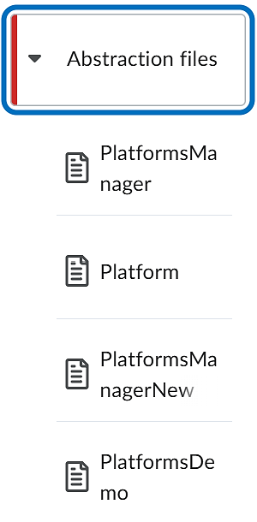
Better design with abstraction
Download the files from LMS.
In groups of 2 or 3, compare these different versions of how to model the platform management.
Unstructured version
Why is the structured version better design?
Structured version
We’ll discuss in class!

Slide 28
The 4 Pillars of
OOP
ABSTRACTION
INHERITANCE
ENCAPSULATION
POLYMORPHISM

Slide 29
Encapsulation in programming is the process of combining elements to create a new entity for the purpose of hiding or protecting information. In OOP, encapsulation is an attribute of object design.
https://www.thoughtco.com/definition-of-encapsulation-958068
The actual drug is hidden
Access to the drug is controlled
ENCAPSULATION
Reduces error
Different drugs can be packaged
Simpler to understand

Slide 30

class HighScore
{
public string Name;
public int Score;
}
HighScore myHighScore = new HighScore();
myHighScore.Name = "Brian";
myHighScore.Score = 100;
HighScore data type definition
Client code that creates and uses HighScore objects
class HighScore
{
public string Name;
public int Score;
}
HighScore myHighScore = new HighScore();
myHighScore.Name = "Brian";
myHighScore.Score = 100;
private string Name;
private int Score
The data is hidden behind a barrier – think of it as an
abstraction barrier

Slide 31
Abstraction
Objects, at the core, are a grouping of related data and operations that act on that data.
Encapsulation
Objects are like black boxes
https://www.youtube.com/watch?v=QbDfy-7cc_c

Slide 32
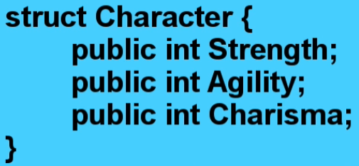

class keyword
class name
class
body of the class
Create a new Character object called fighter
Set the value of the Strength property of fighter
From this line of code only, how do you know that Strength is a public property?

Slide 33



06:15
At this point, I can now pass my fighter around, and it’s going to remember its strength and its agility and its charisma.
And it’s really easy to access that data. whenever I want to check what the fighter’s strength is, I just do:
fighter.Strength
The data is grouped together, and then passed around in your code as a single object.
Strength
fighter
Agility
Charisma
https://www.youtube.com/watch?v=QbDfy-7cc_c

Slide 34
Character fighter = new Fighter();
fighter.Strength = 20;
Strength 20
fighter.Agility = 8;
fighter
Agility 8
fighter.Charisma = 1;
Charisma 1
All the data for a specific character is encapsulated in an object.
No need to keep track of where all the data for a specific character is stored – in multiple variables, arrays, or whatever!
bool IsDead(Character fighter)
{
if(fighter.Strength <= 0)
return true;
return false;
}
Just create an object with all the data in it, and pass the object around!

Slide 35
Objects

Slide 36
Character fighter = new Fighter();
A Character object
An object of type Character
An object that has the data and behaviour defined by the Character data model
What is this?

Slide 37
class Character
{
public int Strength;
public int Agility;
public int Charisma;
}
Character fighter = new Character();
Strength 0
default int value
fighter
Agility 0
Charisma 0
But what if you want to set the values when you create the object?

Slide 38
Strength
Agility
Charisma
Character fighter = new Character(20, 5, 3);
This is starting to look like a function
It is a function!
A special kind of function called a constructor

Slide 39
public Character(int strength, int agility, int charisma)
{
Strength = strength;
Agility = agility;
Charisma = charisma;
}
Character fighter = new Character(20, 5, 3);
Strength 20
fighter
Agility 5
Charisma 3
So if a class can define a special function called a constructor, can it also define any other functions?

Slide 40
class Character
{
public int Strength;
public int Agility;
public int Charisma;
}
YES!
public Character(int strength, int agility, int charisma)
{
Strength = strength;
Agility = agility;
Charisma = charisma;
}
Changes the value of Strength.
public void AddStrength(int amountToAdd)
{
Strength += amountToAdd;
}
Why not just use:
fighter.Strength += 1;
Character fighter = new Character(20, 5, 3);
fighter AddStrength(1);

Slide 41
class Character
{
public int Strength;
public int Agility;
public int Charisma;
private int maxStrength = 50;
// Constructor not shown
}
Client code’s access to the object’s data is controlled
Encapsulation!
public void AddStrength(int amountToAdd)
{
if(Strength + amountToAdd <= maxStrength)
{
Strength += amountToAdd;
}
}
Character fighter = new Character(20, 5, 3);
fighter.Strength += 50;
// DANGER
fighter.AddStrength(50);
// OKAY

Slide 42
class Character
{
private int strength;
private int agility;
private int charisma;
private int maxStrength = 50;
// Constructor not shown
}
Note lower case to indicate private.
But what if external client code wants to know the value of these variables?
public void AddStrength(int amountToAdd)
{
if(Strength + amountToAdd <= maxStrength)
{
Strength += amountToAdd;
}
else
{
Strength = maxStrength;
}
}

Slide 43
class Character
{
private int strength;
private int agility;
private int charisma;
private int maxStrength = 50;
// Constructor not shown
// Other functions not shown
public int GetStrength()
{
return strength;
}
public int GetAgility()
{
return agility;
}
// etc.
Control access to the variable values.
Provide a way to access the variables … but not to change them directly.

Slide 44
class Character
{
private int strength;
private int agility;
private int charisma;
private int maxStrength = 50;
// Constructor not shown
// Other functions not shown
public void SetStrength(int value)
{
if(value <= maxStrength)
{
strength = value;
}
}
If necessary, provide a controlled and safe way to directly set the value of an internal variable.
C# has a more compact syntax →

Slide 45
private int strength;
The technical term for these are
public int Strength
{
get
{
return strength;
}
set
{
strength = value;
}
}
automated properties
fighter.strength
fighter.Strength
You will also see the term getter/setter
value
value
This is done automatically
fighter.Strength = 25;

Slide 46
private int strength;
Your data is gold … protect it!
public int Strength
{
get
{
return strength;
}
set
{
if(value <= maxStrength)
{
strength = value;
}
}
}
Encapsulation!
Shorthand
public int Strength { get; }
https://stackoverflow.com/questions/34743533/automated-property-with-getter-only-can-be-set-why

Slide 47
The 4 Pillars of
OOP
ABSTRACTION
INHERITANCE
ENCAPSULATION
POLYMORPHISM

Slide 48
Type-safety

Slide 49
Player datatype
Character datatype
Lives
hero
Weapon
Health
Character datatype
fighter
Agility
Charisma
Health
Monster datatype
assassin
Agility
Charisma
Magic
boss
Power
Health
bool IsDead(Character object)
{
if(object.Health <= 0)
return true;
return false;
}
Why do you think this is called type-safety?

Slide 50

Character SpellOfDoom(Character character)
{
character.Health = 0;
character.Agility = 0;
character.Charisma = 0;
return character;
}
ERROR!
ERROR!
Character
Player
Monster
Health
Lives
Health
Agility
Weapon
Power
Charisma
Magic
Notes:
https://piq.codeus.net/u/co-sm-ic

Slide 51
Character SpellOfDoom(Character character)
{
character.Health = 0;
character.Agility = 0;
character.Charisma = 0;
return character;
}
Still an error!
Character, Player and Monster are defined and treated as different types
TYPE safety
Not data safety!
Character
Player
Monster
What if …?
Health
Health
Health
Agility
Agility
Agility
Charisma
Charisma
Charisma
Notes:
https://piq.codeus.net/u/co-sm-ic

Slide 52

You can think of type-safety as enforcing a contract between a data item and the client code that uses it …

Slide 53
You can think of type-safety as enforcing a contract between a datatype and the client code that uses it
I’m an int … you can add, subtract, multiply with me. For other operations and more details, see my documentation!
I’m a string … you can check my length, and concat me with another string. For other operations and more details, see my documentation!
5
“Hi”
I’m a Character… you can check my Strength, Agility and Charisma properties. For other operations and more details, see my documentation!
I’m a List… you can check my length, and add or remove items. For other operations and more details, see my documentation!

Slide 54


Inheritance
Let’s say our characters are superheroes
Superclass
Subclass

Slide 55

Every superhero has a method called Fight.
But does each superhero fight in the same way? No!
FIGHT
FIGHT
?
?

Slide 56
Every superhero has a method called Fight.
But does each superhero fight in the same way? No!
FIGHT
FIGHT
Step 1: Open visor
Step 2: Shoot beam
Step 3: Close visor
Step 1: Raise temperature
Step 2: Start fire
Step 3: Cover body in fire
Step 4: Shoot firebolt

Slide 57
Each superhero must have their own way of fighting!
Each superhero must have a different fight method.
Cyclops
Human Torch
fight
open visor
shoot beam
close visor
end
fight
raise temperature
start fire
cover body in fire
shoot firebolt
end
We can create different types of superheroes!

Slide 58
Superhero
Cyclops
Human Torch
fight
open visor
shoot beam
close visor
end
fight
raise temp
start fire
cover body in fire
shoot firebolt
end

Slide 59
Superhero
NAME
POWER
ACTIVE
FIGHT
RETREAT
Extends
Cyclops
Human Torch
fight
open visor
shoot beam
close visor
end
NAME
POWER
ACTIVE
FIGHT
RETREAT
NAME
POWER
ACTIVE
FIGHT
RETREAT
fight
raise temp
start fire
shoot firebolt
end

Slide 60
We write the Cyclops and Human Torch classes as extensions of the Superhero class.
public class Superhero {
public virtual void fight(){}
}
public class Cyclops extends Superhero {
public override void fight() {
// open visor
// shoot beam
// close visor
}
}
public class HumanTorch extends Superhero {
public override void fight() {
// raise temp
// start fire
// shoot firebolt
}
}
This is called method overriding

Slide 61
The 4 Pillars of
OOP
ABSTRACTION
INHERITANCE
ENCAPSULATION
POLYMORPHISM

Slide 62
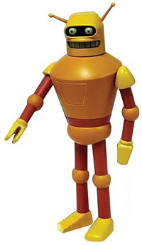
Consider the class SimpleCalc.
This can perform a basic add operation.
SimpleCalc
Add()
ComplexCalc
Multiply()
We can define an extended class called ComplexCalc that inherits the add operation from SimpleCalc, but defines an extra multiply operation.

Slide 63
public class SimpleCalc
{
public float Add(float x, float y)
{
return x + y;
}
}
In code
public class ComplexCalc
{
public float Multiply(float x, float y)
{
return x * y;
}
}
SimpleCalc
Add()
ComplexCalc
Multiply()
Notes:
http://clipart.m-y-d-s.com

Slide 64
SimpleCalc s = new SimpleCalc();
ComplexCalc c = new ComplexCalc();
Add()
s.Add(1,1); // returns 2
c.Multiply(2,3); // returns 6
c.Add(1,1); // returns 2
Add()
Multiply()
s.Multiply(2,3); // Possible???
ComplexCalc extends SimpleCalc, so a SimpleCalc type cannot behave like a ComplexCalc type.
SimpleCalc
Add()
After casting ComplexCalc to SimpleCalc, only Add() is accessible. Multiply() is hidden unless the object is treated as a ComplexCalc again.
ComplexCalc
Multiply()
Notes:
perso.bonvalet.fr

Slide 65
Since ComplexCalc extends SimpleCalc, this means that ComplexCalc inherits everything from SimpleCalc.
SimpleCalc
add()
So, wherever a SimpleCalc object is required, you could use a ComplexCalc object instead.
ComplexCalc
But you have to tell the compiler that you want the ComplexCalc object to act like SimpleCalc.
Multiply()
This is called type casting.
Add()
Add()
Multiply()
I can be just like a SimpleCalc
Notes:
silversnail.com

Slide 66
You do it like this:
(SimpleCalc)c
SimpleCalc
Add()
Type casting
ComplexCalc
The cast operation changes the type of an object – in this case, to its superclass.
Multiply()
SimpleCalc s;
ComplexCalc c = new ComplexCalc();
s = (SimpleCalc)c;
It’s really a ComplexCalc object, but has been type cast to SimpleCalc.
The program now treats the ComplexCalc object as a SimpleCalc object.
Notes:
http://www.shoppingbank.com

Slide 67
public class MathEngine
{
private SimpleCalc _simple;
public void SetAddingDevice(SimpleCalc sc)
{
_simple = sc;
}
}
public class SimpleCalc
{
public float Add(float x, float y)
{
return x + y;
}
}
public class ComplexCalc : SimpleCalc
{
public float Multiply(float x, float y)
{
return x * y;
}
}
Who can explain what’s happening here?
public class Program
{
public static void Main()
{
MathEngine engine = new MathEngine();
SimpleCalc simple = new SimpleCalc();
engine.SetAddingDevice(simple);
ComplexCalc complex = new ComplexCalc();
SimpleCalc newSimple = complex;
engine.SetAddingDevice(newSimple);
engine.SetAddingDevice(complex);
}
}

Slide 68

ComplexCalc
type cast to SimpleCalc
MathEngine’s setAddingDevice function requires a SimpleCalc object.
Since ComplexCalc is a subclass of SimpleCalc, you can create a ComplexCalc object, then cast it to SimpleCalc .
As far as MathEngine is concerned, all it sees is a SimpleCalc object.

Slide 69
Explicit
Two ways to cast
Implicit
ComplexCalc complex = new ComplexCalc();
SimpleCalc simple = (SimpleCalc)complex;
engine.setAddingDevice((SimpleCalc)complex);
Explicit
Explicit
SimpleCalc simple = complex;
engine.setAddingDevice(complex);
Implicit
Implicit

Slide 70
In this example, we can print an object out in string form without knowing the precise type of the object (e.g. int, string, float).
void Print(object o)
{
Console.WriteLine(o.ToString());
}
Print(42);
Print(“abcd”);
Print(3.145f);
Print(new Point(23,45));
The ability to perform an operation on an object without knowing the precise type of the object is called …
https://ecs.syr.edu/faculty/fawcett/Handouts/coretechnologies/CSharp/presentations/IntroductionToCSharp.ppt

Slide 71
Polymorphism
poly = many
morph = shape
Polymorphism is the ability of one type, A, to appear as and be used like another type, B.
wikipedia
Polymorphism is the ability of objects belonging to different classes to respond to operations of the same name, each one according to the right class-specific behaviour.
www.novio.be/blog/?p=621
The primary usage of polymorphism in industry is the ability of objects belonging to different types to respond to method, field, or property calls of the same name.
Wikipedia (again)

